Slide 1
Orphanage Management
System.

Slide 2

PROJECT MEMBERS
SOHAN CHAVAN
PRASHANT GHADGE
2

Slide 3
INTRODUCTION
An orphanage is a place where children parents are cared for and housed. If a child has parents – because the parents died or lost custody – the child is considered an orphan. Orphans are parentless. An orphanage is an institution that takes care of orphans.
Most of the time, children are left in orphanages because their widowed mother cannot afford to take care of them and their fathers are gone through disease or conflict.
3

Slide 4
PROBLEM STATEMENT :
The care of orphans, in every country, is a matter of national policy.
But orphans are orphans within governments too.
Orphans are invisible; they don't vote; they aren't politically aligned so they lack advocates. Parents and communities are natural advocates for their children: their schools, their health, their safety.
In the absence of parents, orphan children become a "burden" to society.
The values and priorities of the society will determine how that "burden" is managed.
4

Slide 5
Proposed Method :
The main purpose of an intelligent virtual assistant is to answer questions that users may have. It will be capable to perform general interactions, searching topics on the Wikipedia, send emails, play songs, and many more tasks.
Virtual assistants can tremendously save you time. We spend hours in online research and then making the report in our terms of understanding. Alpha assistant can do that for you. Provide a topic for research and continue with your tasks while Alpha does the research.
5

Slide 6
EXSISTING SYSTEM:
An Information System (IS) is the set of software, data, people and procedures that work together to produce information. Information is a valuable and costly asset that must be preserved, protected, controlled and planned for, as other valuable asset with an organization such as money, facilities and people.
Information is more than books, it is considered useful or worthy of retention if over a period of time it appears in many forms other than that of traditional book. Also, information may be considered as recorded knowledge that may be useful to some decision makers and this recorded knowledge may be found in such sources as inventory reports etc.
6

Slide 7
Scope of project :
We can create Android or iOS application for this project.
We can create a news window for farmers information.
7

Slide 8
HARDWARE AND SOFTWARE REQUIREMENTS:
Language(s) to be used:
HTML & CSS
Javascript
Hardware Requirements:
RAM: 1 GB or more
Hard Disc: 200MB or more
Processor: Intel core processor
Processor Speed: 2.3 GHz
Software Requirements:
HTML & CSS
Javascript
Sublime Text 3.1.1- Sublime Text is a sophisticated text editor for coding.
Browser: Google Chrome, Mozilla Firefox, Internet explorer’s
8

Slide 9
Conclusion:
Orphanage is the name to describe a residential institution dedicated to the care of orphans whose parents are deceased. Parent or any legal guardian responsible for supporting the child or children, but in the absence of these guardian to take responsibility for the children, they lose all the care and attention to fit into their surroundings. This paper and proposed design (system) of an orphanage home management information system that will eliminate the conventional manual (Paper) management to a digitized (computerized) management system. The study so far has looked at vast importance of computer Information System (IS) and how they are applied to the information and management in the orphanages information.

Slide 10
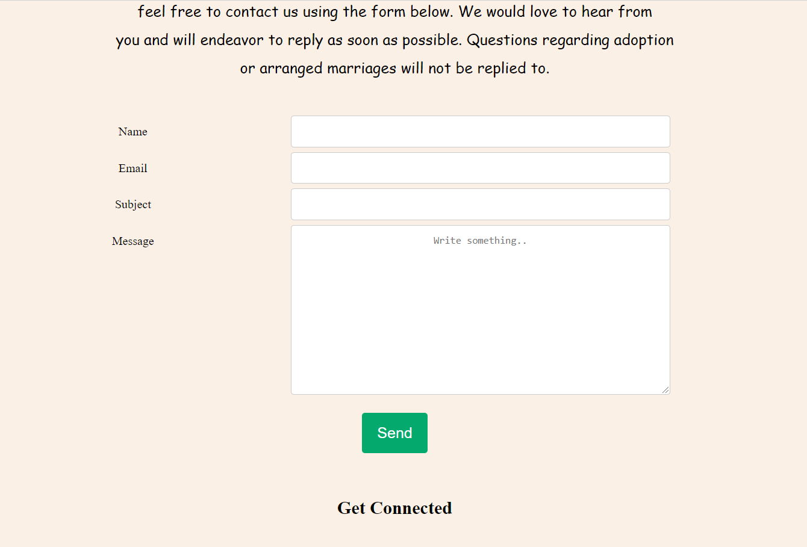
Contact us form

Slide 11
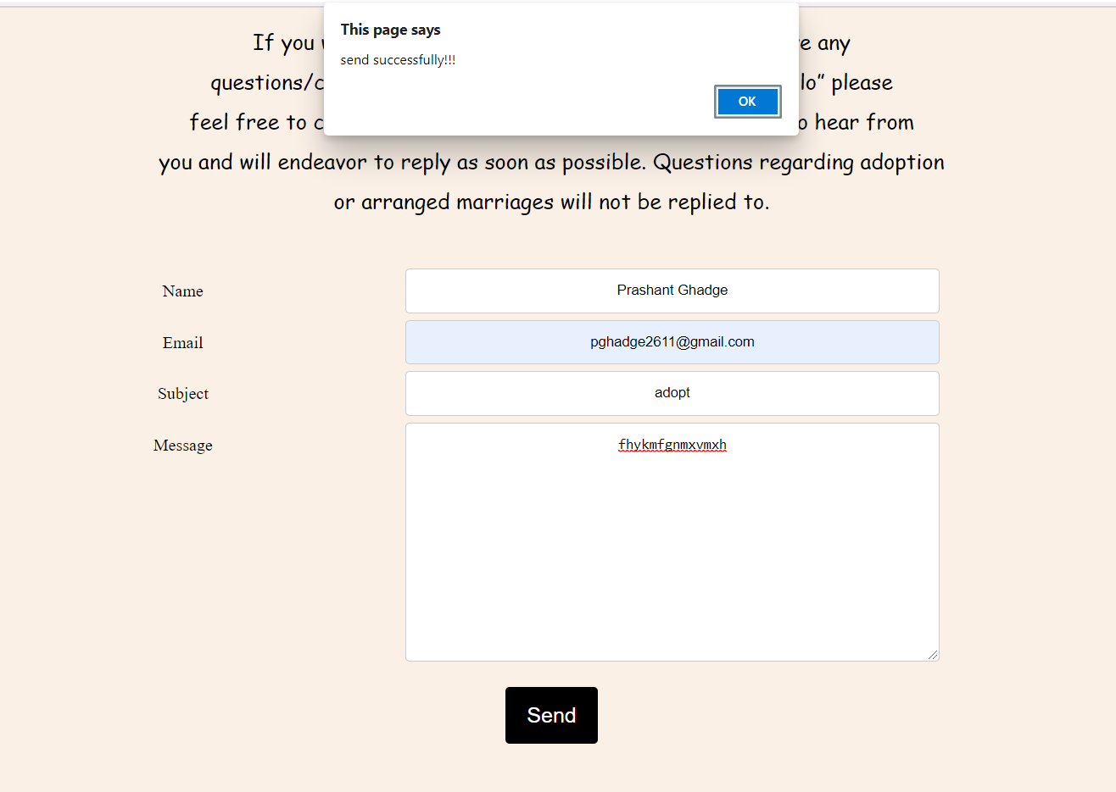




Slide 12
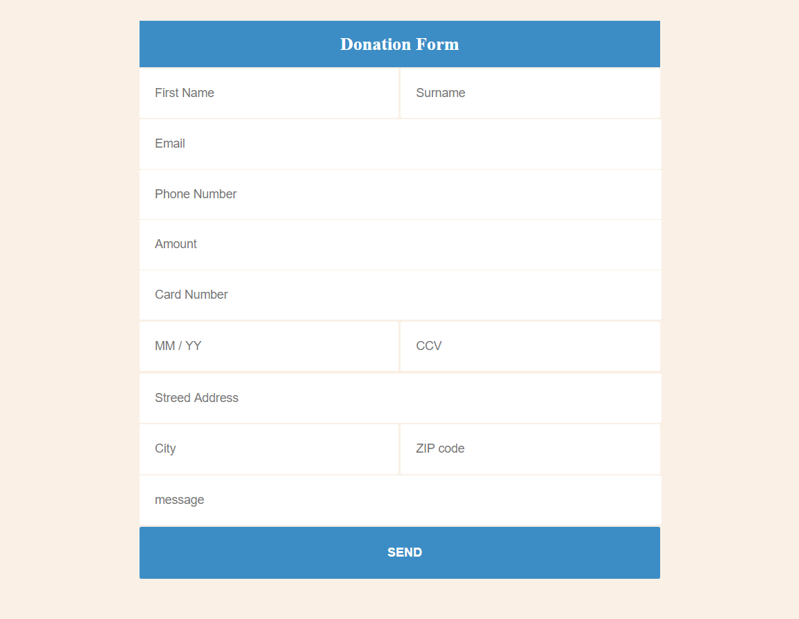
Donation Form
12

Slide 13
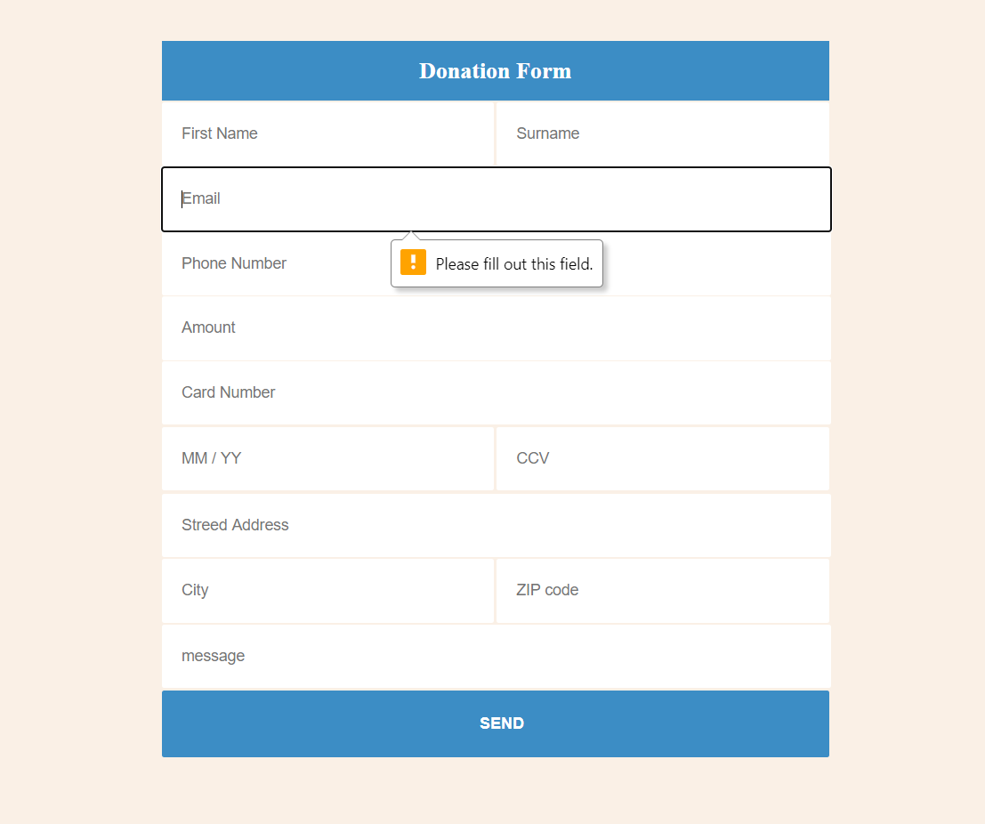
Fill data correctly

Slide 14
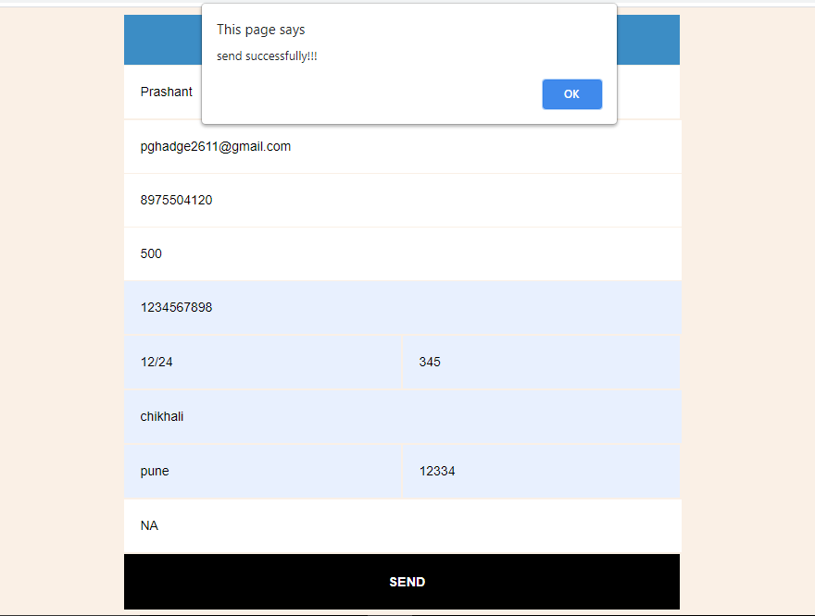
Donation Form Successful Submitted

Slide 15
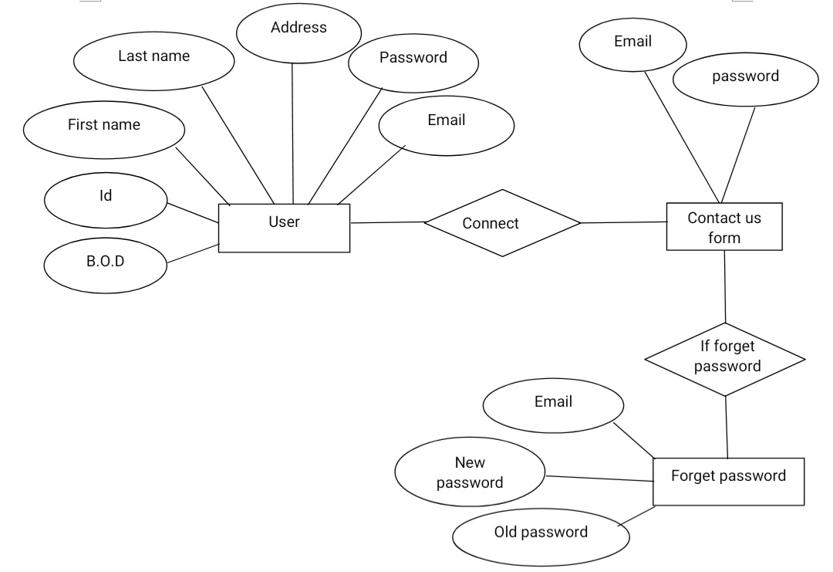
Er diagram: Admin control

Slide 16
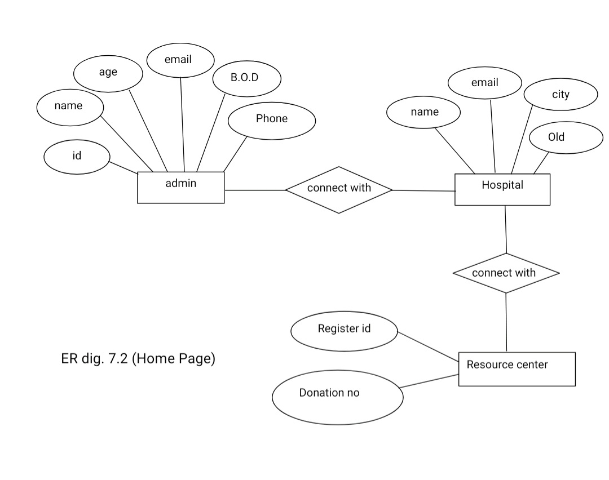

Slide 17
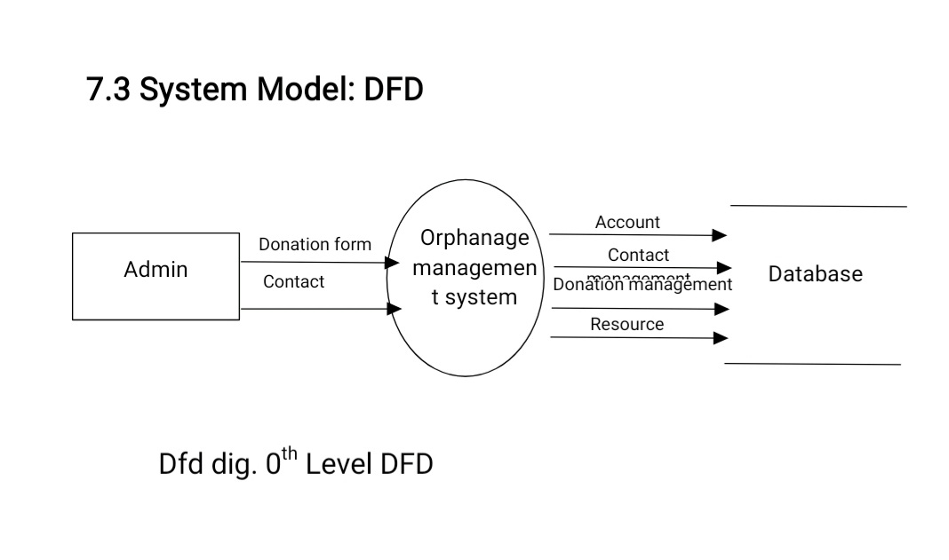

Slide 18
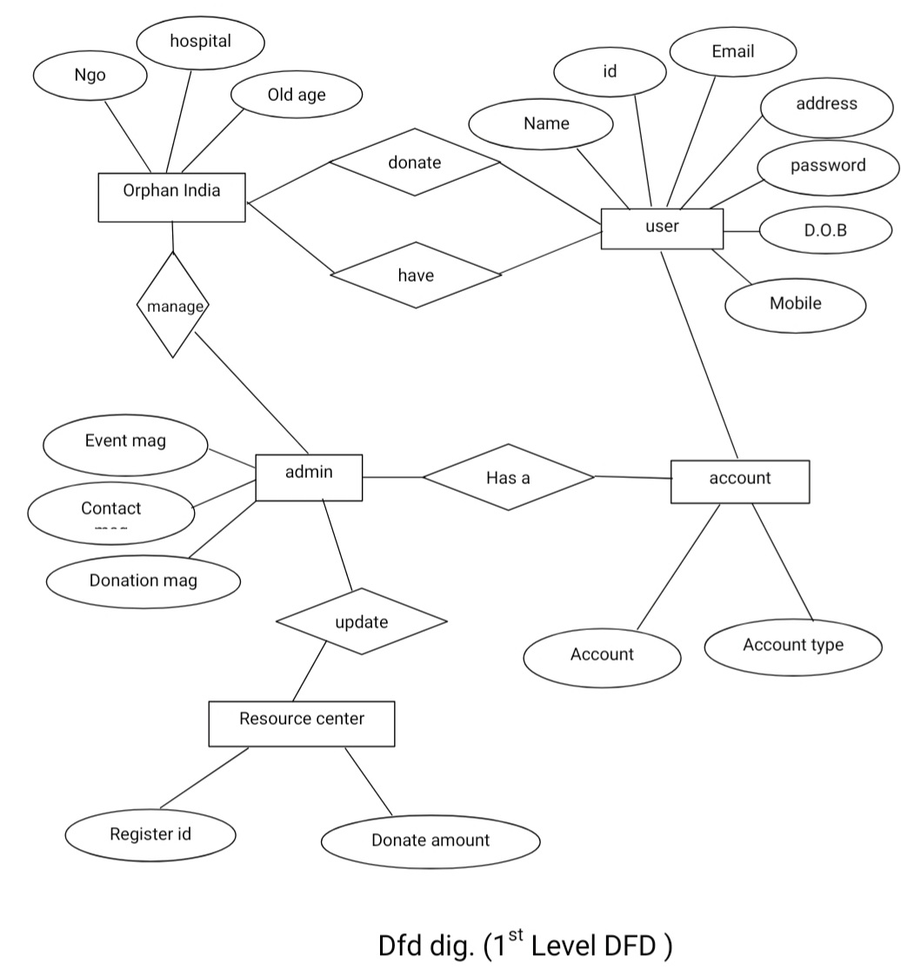

Slide 19
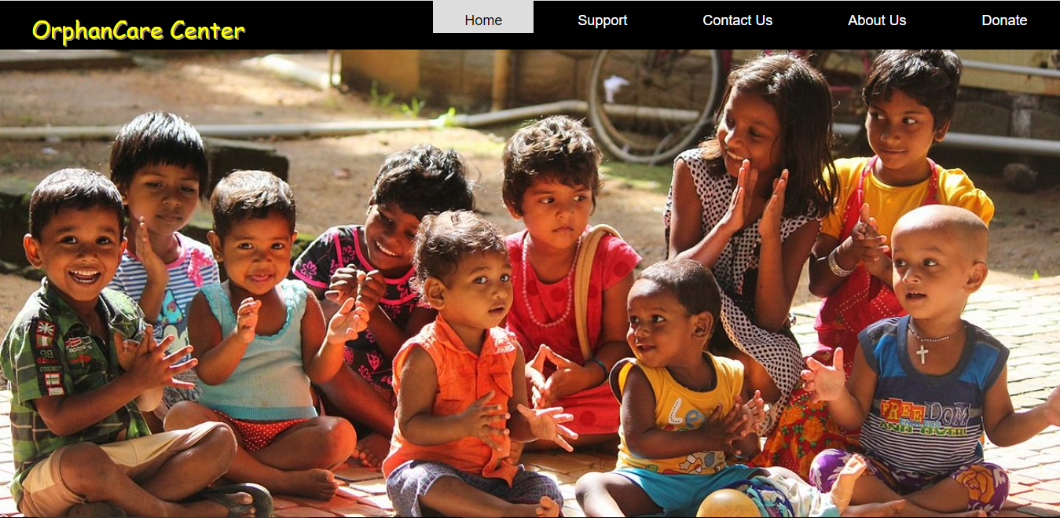

Slide 20


FR

